Slide 1
Teaching English to learners with Special Educational Needs
Гончарова Наталія Валеріївна
Вчитель іноземної мови (англійська)
Балаклійської загальноосвітньої
школи І-ІІІ ступенів №2

Slide 2
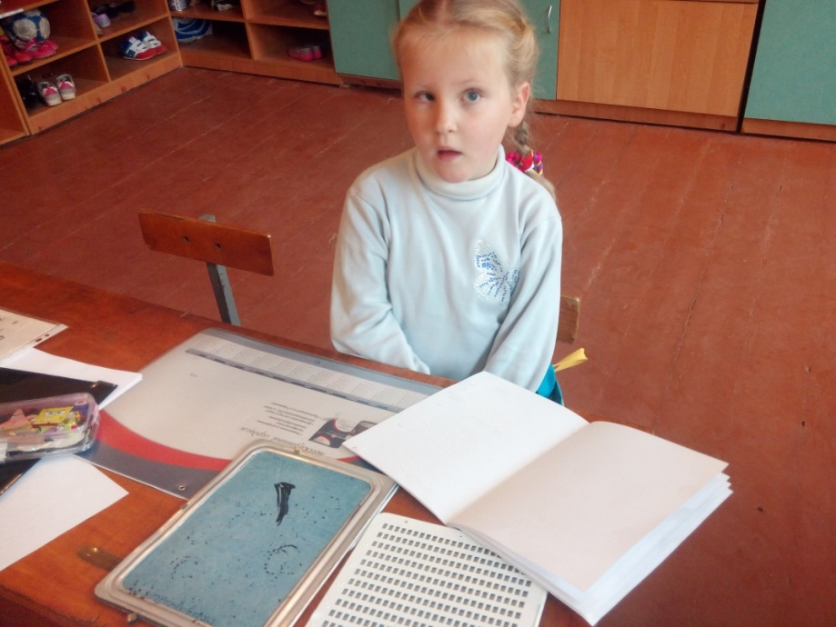
http://gonnv.ucoz.com/video
In my case I teach English to a child with Special Education Needs. This is a blind girl.
She is seven.
She is a pupil of the first form.

Slide 3
Advantages in teaching English of kids with visual impairments:
Fine sense of smell;
Fine hearing;
Fine tactile sensibility;
High level of intellect.

Slide 4
Disadvantages: learners with SENs have some problems in
reading
writing
spelling

Slide 5
Methods:
Verbal:
Dialogues;
Stories;
Fair tails;
Songs;
Poems;
Chants.
Didactic games:
Role;
Moving.

Slide 6
Forms:
Individual work:
Repeating after the teacher;
Feeling of things or toys.
Pair work:
Asking and answering the questions;
Conversation.
Group work:
Giving instructions and doing them;
Repeating altogether.

Slide 7
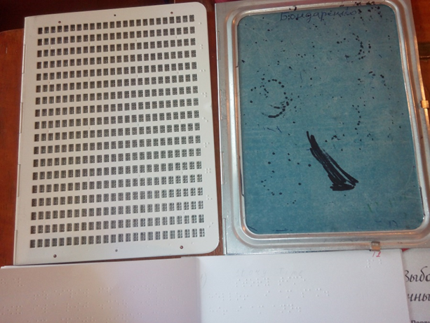
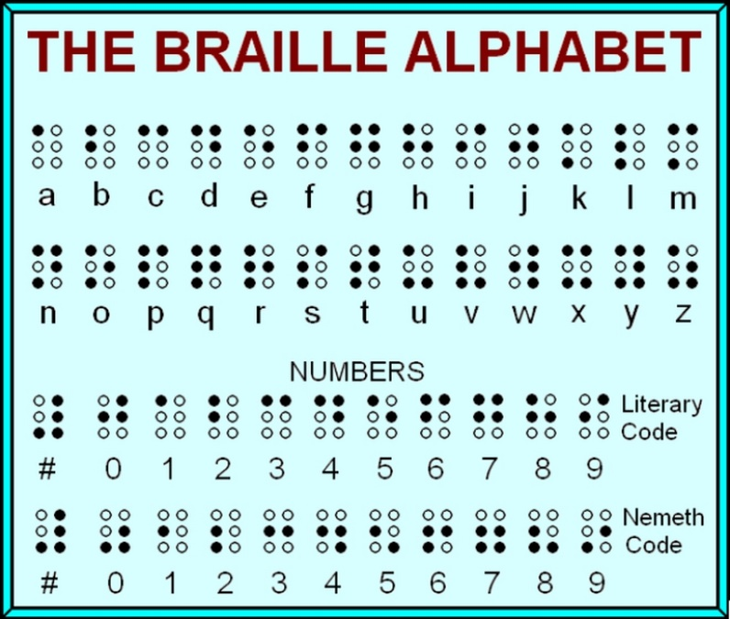
Teacher`s problems:
Inexperience in teaching kids with Special Educational Needs;
Non – acquaintance the Braille alphabet;
Absence of special books and equipment.

Slide 8
The fist episode. Theme “Introduction”
I use:
Verbal method (the dialogue)
Hello! How are you?
I am fine. Thank you!
Pair work (teacher-pupil)
Didactic game “The yellow ball”

Slide 9
The second episode. Theme: “Forms of greeting”
I use:
Moving game (the song “Good morning”)
Individual work.

Slide 10
The third episode. Theme: “School. School things”
I use
Pair and group work
(Teacher – Pupil; pupil – pupil)
Role game “At school or a strict teacher”
Notes:
We repeated phases: Stand up! Sit down! Take your pen, please!

Slide 11
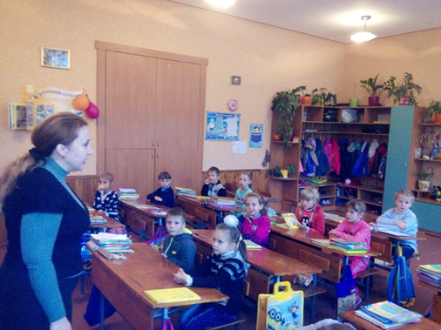
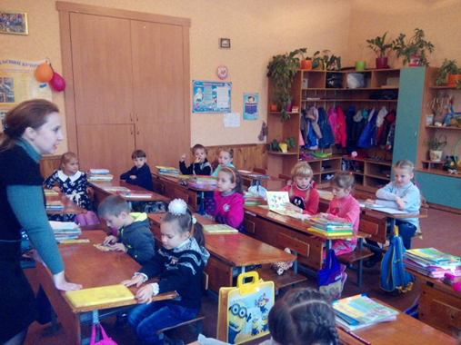
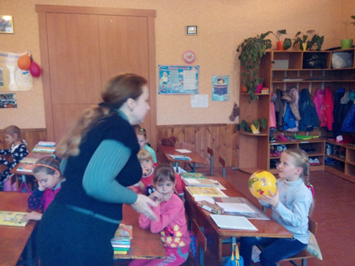
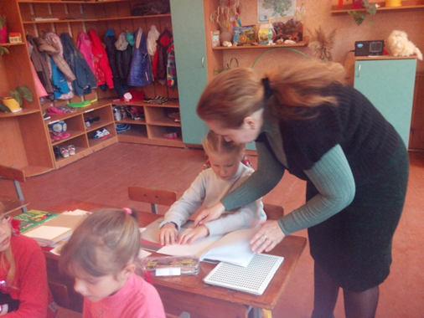
I adopted the school material in such way that the child with SENs:
Can develop his or her academic skills
Can be successful
Can feel comfort

Slide 12
Thank you for attention!

